Slide 1
Chapter 29 - Java Graphical User Interface Components
Outline
29.1 Introduction
29.2 Swing Overview
29.3 JLabel
29.4 Event Handling Model
29.5 JTextField and JPasswordField
29.5.1 How Event Handling Works
29.6 JTextArea
29.7 JButton
29.8 JCheckBox
29.9 JComboBox
29.10 Mouse Event Handling
29.11 Layout Managers
29.11.1 FlowLayout
29.11.2 BorderLayout
29.11.3 GridLayout
29.12 Panels
29.13 Creating a Self-Contained Subclass of JPanel
29.14 Windows
29.15 Using Menus with Frames

Slide 2
Objectives
In this chapter, you will learn:
  To understand the design principles of graphical user interfaces.
  To be able to build graphical user interfaces.
  To understand the packages containing graphical user interface components and event handling classes and interfaces.
  To be able to create and manipulate buttons, labels, lists, text fields and panels.
  To understand mouse events and keyboard events.
  To understand and be able to use layout managers.

Slide 3
29.1 Introduction
Graphical User Interface ("Goo-ee")
  Pictoral interface to a program
    Distinctive "look" and "feel"
  Different applications with consistent GUIs improve productivity
Example: Netscape Communicator
  Menu bar, text field, label
GUIs built from components
  Component: object with which user interacts
  Examples: Labels, Text fields, Buttons, Checkboxes

Slide 4
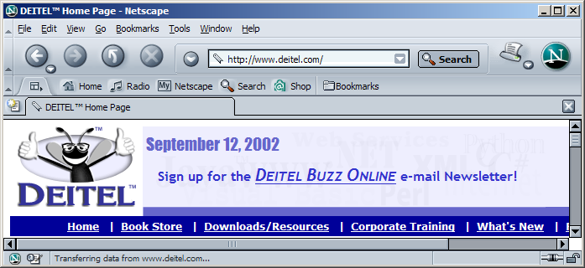
29.1 Introduction
Button
Label
Menu
Menu bar
Text field

Slide 5
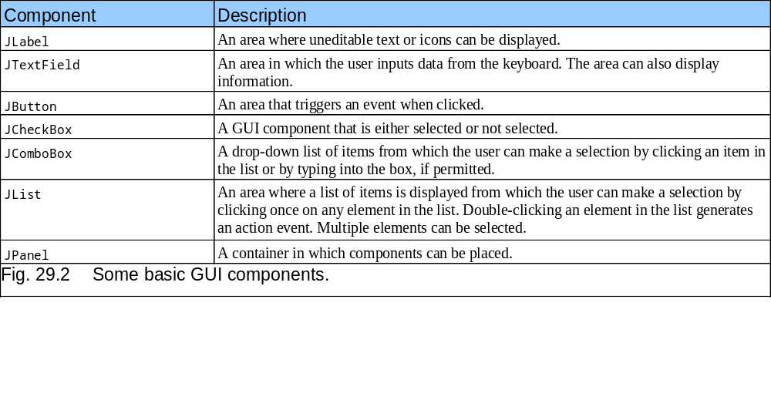
29.1 Introduction

Slide 6
29.2 Swing Overview
Swing GUI components
  Defined in package javax.swing
  Original GUI components from Abstract Windowing Toolkit in java.awt
    Heavyweight components - rely on local platform's windowing system for look and feel
  Swing components are lightweight
    Written in Java, not weighed down by complex GUI capabilities of platform
    More portable than heavyweight components
  Swing components allow programmer to specify look and feel
    Can change depending on platform
    Can be the same across all platforms

Slide 7
29.2 Swing Overview
Swing component inheritance hierarchy
    Component defines methods that can be used in its subclasses (for example, paint and repaint)
    Container - collection of related components
      When using JFrames, attach components to the content pane (a Container)
      Method add to add components to content pane
    JComponent - superclass to most Swing components
    Much of a component's functionality inherited from these classes
java.lang.Object
java.awt.Component
java.awt.Container
javax.swing.JComponent

Slide 8
29.3 JLabel
Labels
  Provide text instructions on a GUI
  Read-only text
  Programs rarely change a label's contents
  Class JLabel (subclass of JComponent)
Methods
  Can define label text in constructor
  myLabel.setToolTipText( "Text" )
    Displays "Text"in a tool tip when mouse over label
  myLabel.setText( "Text" )
  myLabel.getText()

Slide 9
29.3 JLabel
Icon
  Object that implements interface Icon
  One class is ImageIcon (.gif and .jpeg images)
  Display an icon with setIcon method (of class JLabel)
    myLabel.setIcon( myIcon );
    myLabel.getIcon //returns current Icon
Alignment
  Set of integer constants defined in interface SwingConstants (javax.swing)
    SwingConstants.LEFT
    Use with JLabel methods setHorizontalTextPosition and setVerticalTextPosition

Slide 10
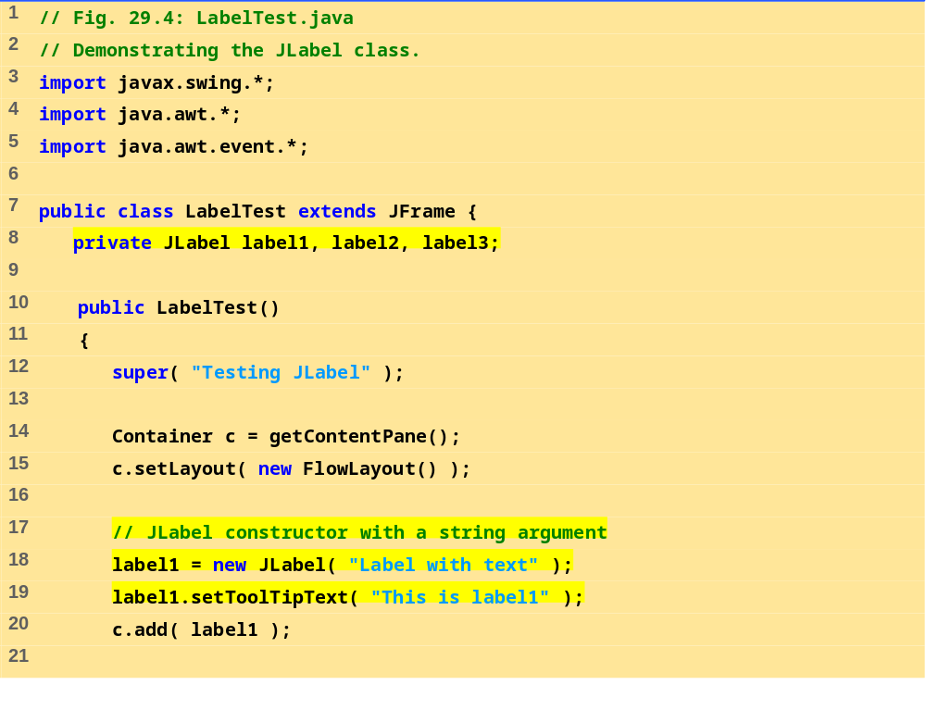
LabelTest.java (Part 1 of 3)

Slide 11
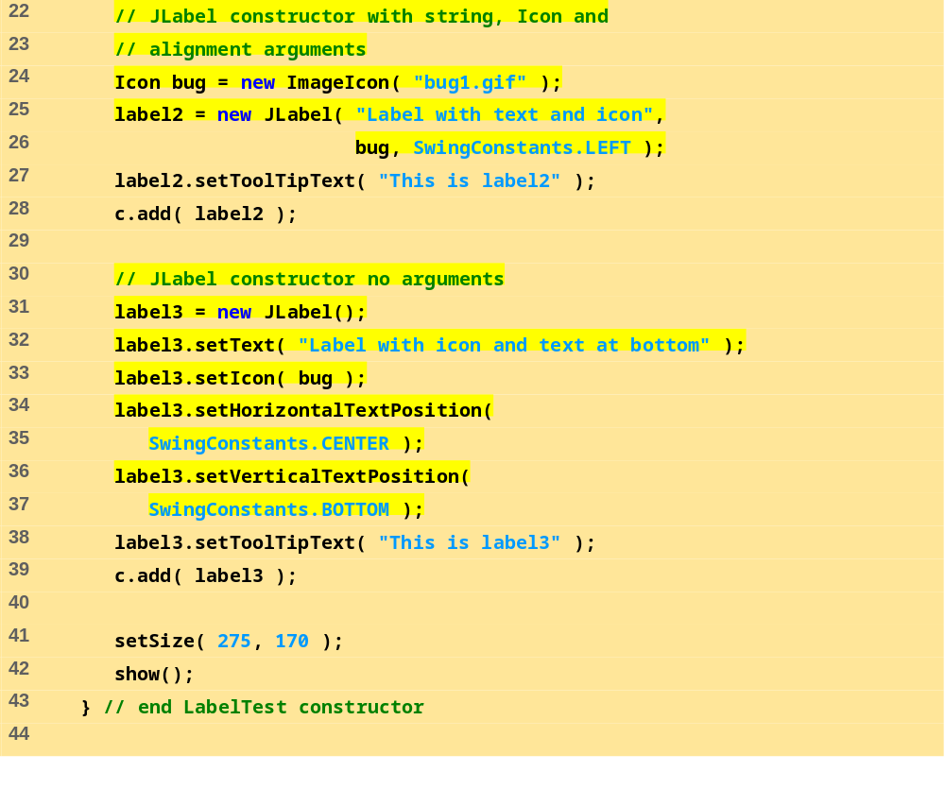
LabelTest.java (Part 2 of 3)

Slide 12
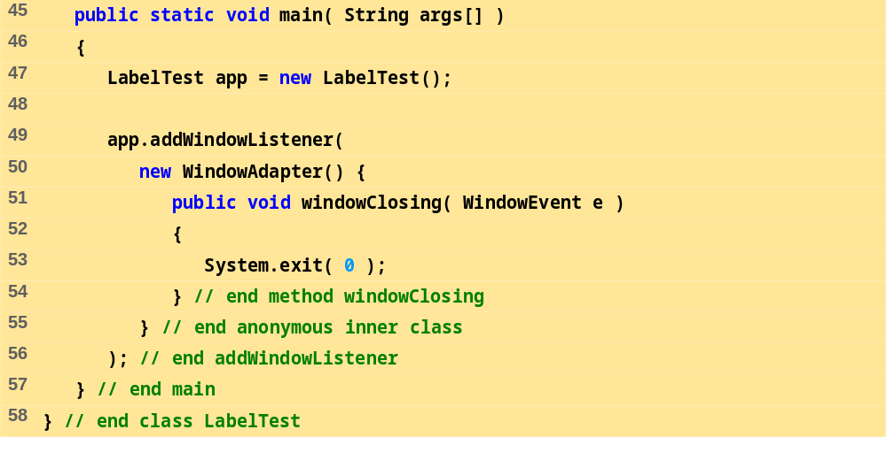
LabelTest.java (Part 3 of 3)

Slide 13
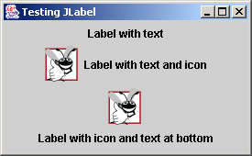
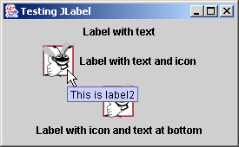
Program Output

Slide 14
29.4 Event Handling Model
GUIs are event driven
  Generate events when user interacts with GUI
    Mouse movements, mouse clicks, typing in a text field, etc.
  Event information stored in object that extends AWTEvent
To process an event
  Register an event listener
    Object from a class that implements an event-listener interface (from java.awt.event or javax.swing.event)
    "Listens" for events
  Implement event handler
    Method that is called in response to an event
    Each event handling interface has one or more event handling methods that must be defined

Slide 15
29.4 Event Handling Model
Delegation event model
  Use of event listeners in event handling
  Processing of event delegated to particular object
When an event occurs
  GUI component notifies its listeners
    Calls listener's event handling method
Example:
  Enter pressed in a JTextField
  Method actionPerformed called for registered listener
  Details in following section

Slide 16
29.4 Event Handling Model
java.lang.Object
ActionEvent
ContainerEvent
java.util.EventObject
AdjustmentEvent
FocusEvent
ItemEvent
PaintEvent
java.awt.AWTEvent
ComponentEvent
WindowEvent
Key
InputEvent
Class name
Interface Name
KeyEvent
MouseEvent

Slide 17
29.4 Event Handling Model
ActionListener
AdjustmentListener
java.util.EventListener
ComponentListener
ContainerListener
FocusListener
ItemListener
KeyListener
MouseListener
MouseMotionListener
Key
Class name
TextListener
Interface Name
WindowListener

Slide 18
29.5 JTextField and JPasswordField
JTextFields and JPasswordFields
  Single line areas in which text can be entered or displayed
  JPasswordFields show inputted text as *
  JTextField extends JTextComponent
    JPasswordField extends JTextField
When Enter pressed
  ActionEvent occurs
  Currently active field "has the focus"
Methods
  Constructor
    JTextField( 10 ) - sets textfield with 10 columns of text
    JTextField( "Hi" ) - sets text, width determined automatically

Slide 19
29.5 JTextField and JPasswordField
Methods (continued)
  setEditable( boolean )
    If true, user can edit text
  getPassword
    Class JPasswordField
    Returns password as an array of type char
Example
  Create JTextFields and a JPasswordField
  Create and register an event handler
    Displays a dialog box when Enter pressed

Slide 20
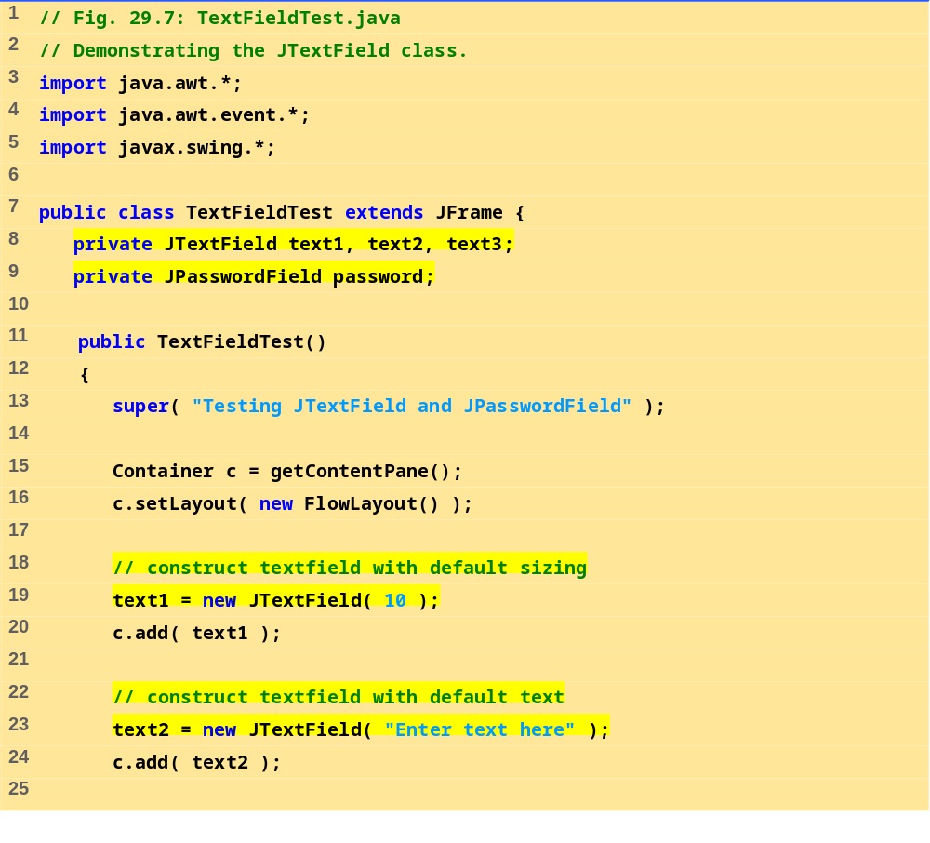
TextFieldTest.java (Part 1 of 4)

Slide 21
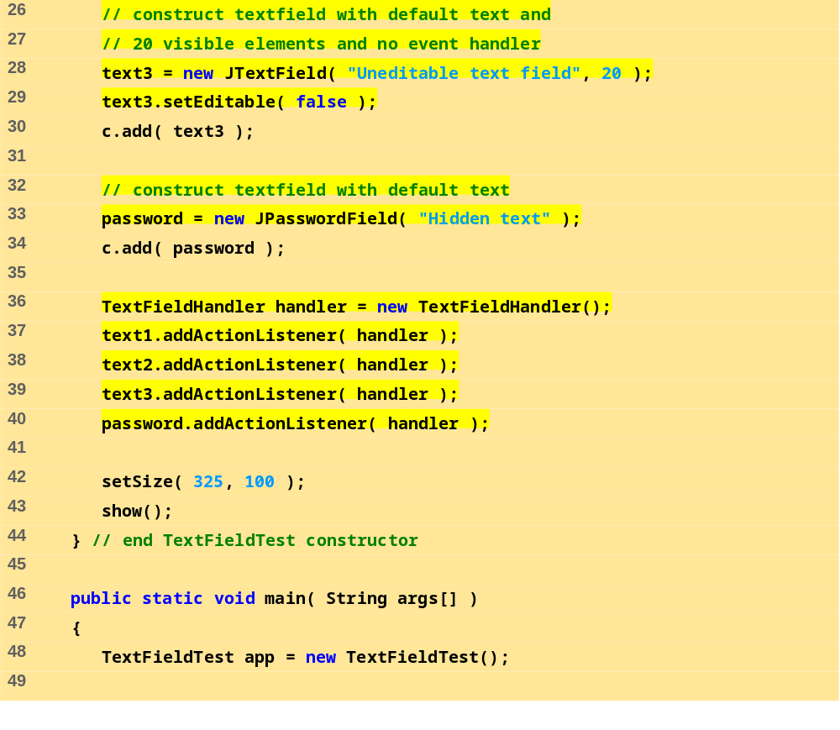
TextFieldTest.java (Part 2 of 4)

Slide 22
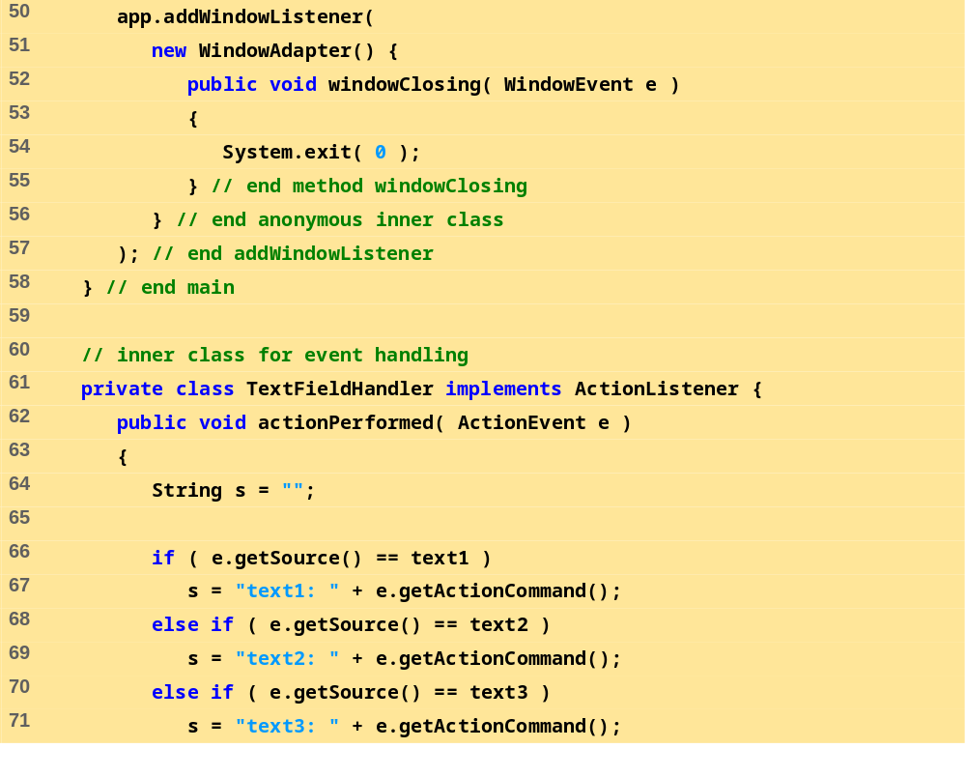
TextFieldTest.java (Part 3 of 4)
e.getSource() returns a Component reference, which is cast to a JPasswordField

Slide 23
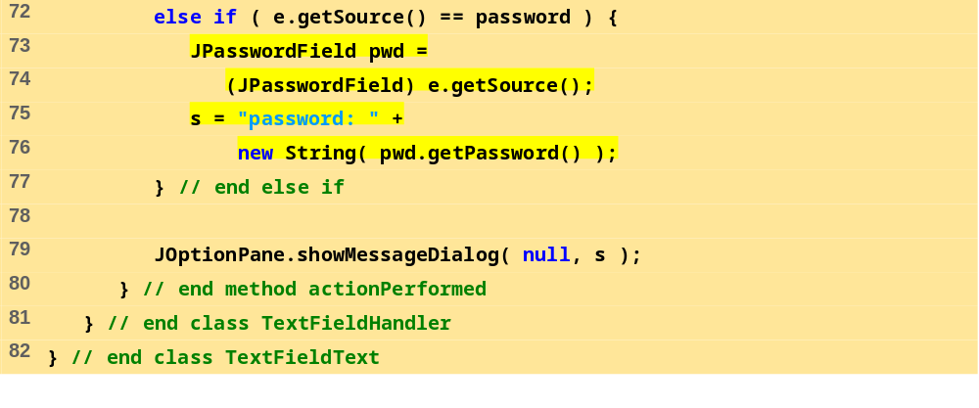
TextFieldTest.java (Part 4 of 4)

Slide 24
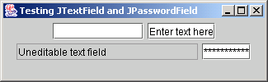
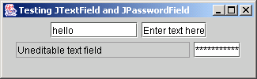
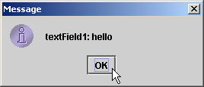
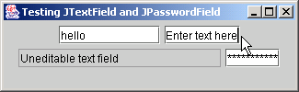
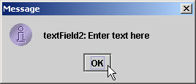
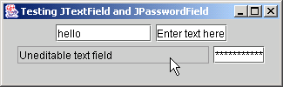
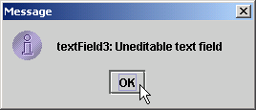
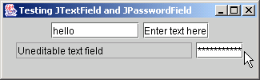
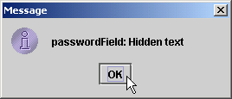
Program Output

Slide 25
29.5.1 How Event Handling Works
Registering event listeners
  All JComponents contain an object of class EventListenerList called listenerList
  When text1.addActionListener( handler ) executes
    New entry placed into listenerList
Handling events
  When event occurs, has an event ID
    Component uses this to decide which method to call
    If ActionEvent, then actionPerformed called (in all registered ActionListeners)

Slide 26
29.5.1 How Event Handling Works
text1
This is the JTextField object. It contains an instance variable of type EventListenerList called listenerList that it inherited from class JComponent.
handler
This is the TextFieldHandler object that implements ActionListener and defines method actionPerformed.
public void
actionPerformed(
ActionEvent e )
{ // event handled here
}
listenerList
...
This reference is created by the statement
text1.addActionListener( handler );

Slide 27
29.6 JTextArea
Area for manipulating multiple lines of text
  Like JTextField, inherits from JTextComponent
  Many of the same methods
JScrollPane
  Provides scrolling
  Initialize with component
    new JScrollPane( myComponent )
  Can set scrolling policies (always, as needed, never)
    See book for details

Slide 28
29.6 JTextArea
Box container
  Uses BoxLayout layout manager
  Arrange GUI components horizontally or vertically
  Box b = Box.createHorizontalbox();
    Arranges components attached to it from left to right, in order attached

Slide 29
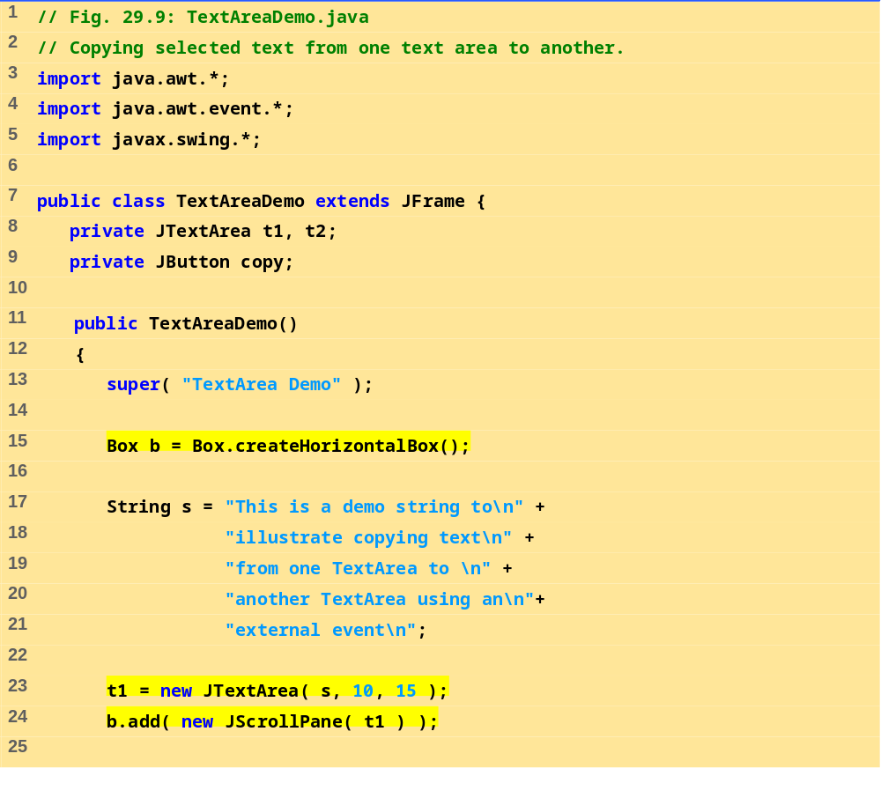
TextAreaDemo.java (Part 1 of 3)
Initialize JScrollPane to t1 and attach to Box b

Slide 30
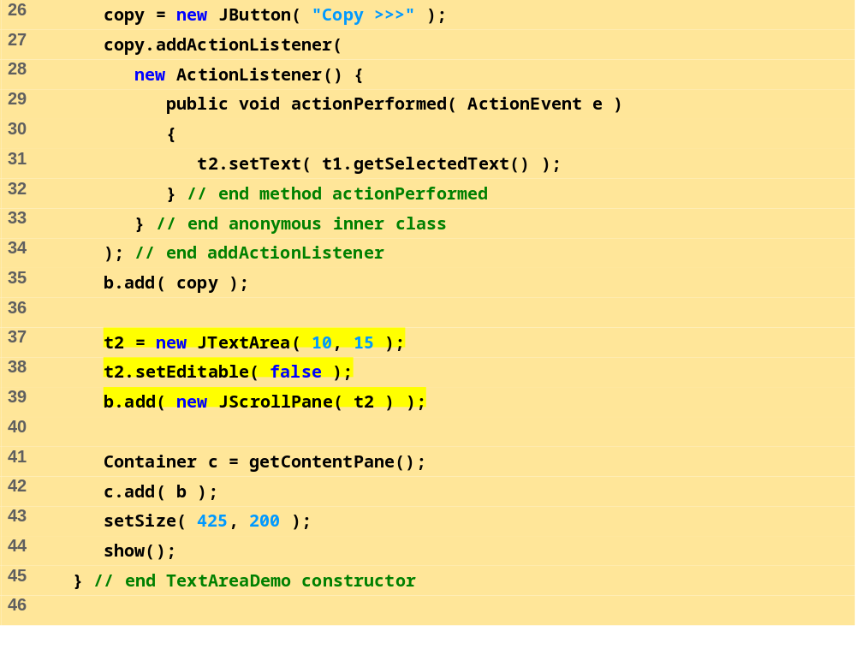
TextAreaDemo.java (Part 2 of 3)

Slide 31
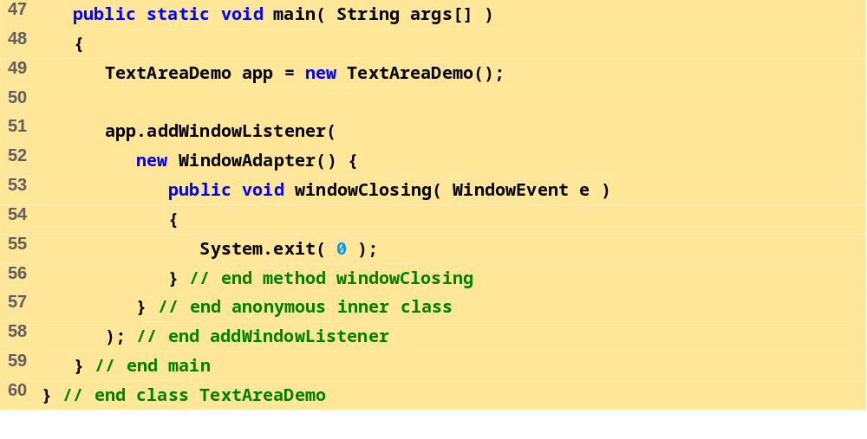
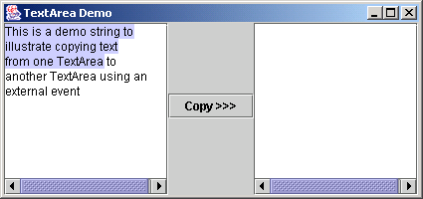
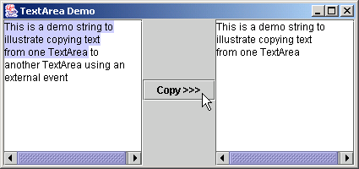
TextAreaDemo.java (Part 3 of 3)
Program Output

Slide 32
29.7 JButton
Button
  Component user clicks to trigger an action
  Several types of buttons
    Command buttons, toggle buttons, check boxes, radio buttons
Command button
  Generates ActionEvent when clicked
  Created with class JButton
    Inherits from class AbstractButton
Jbutton
  Text on face called button label
  Each button should have a different label
  Support display of Icons

Slide 33
29.7 JButton
javax.swing.JComponent
javax.swing.AbstractButton
javax.swing.JButton
javax.swing.ToggleButton
javax.swing.JCheckBox
javax.swing.JRadioButton

Slide 34
29.7 JButton
Constructors
  Jbutton myButton = new JButton( "Button" );
  Jbutton myButton = new JButton( "Button", myIcon );
Method
  setRolloverIcon( myIcon )
    Sets image to display when mouse over button

Slide 35
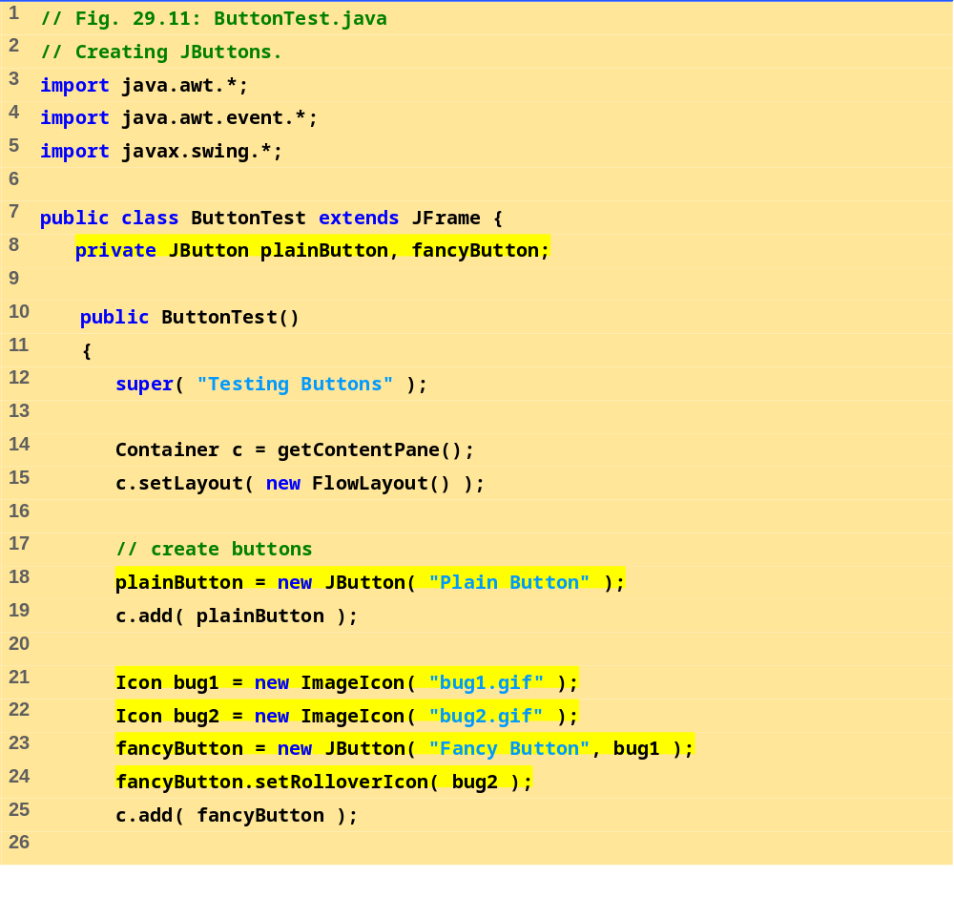
ButtonTest.java (Part 1 of 3)

Slide 36
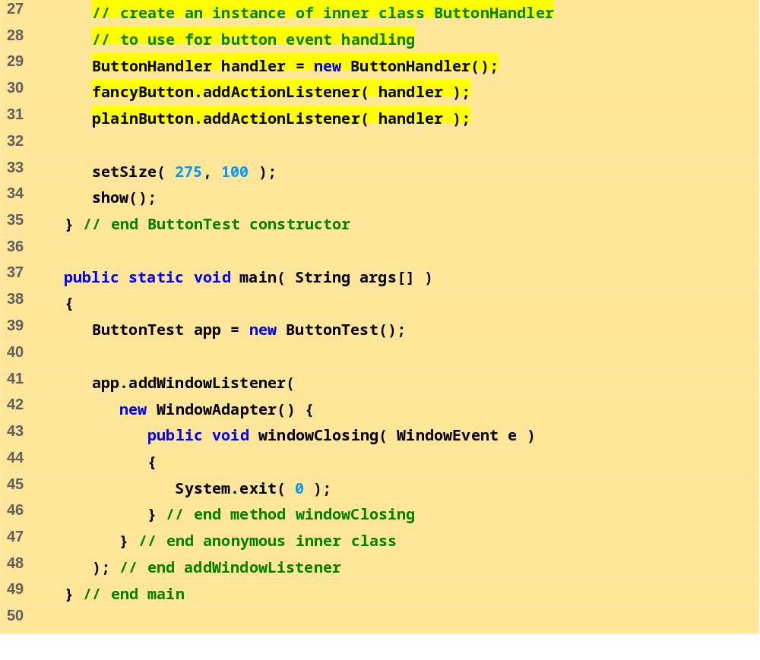
ButtonTest.java (Part 2 of 3)

Slide 37
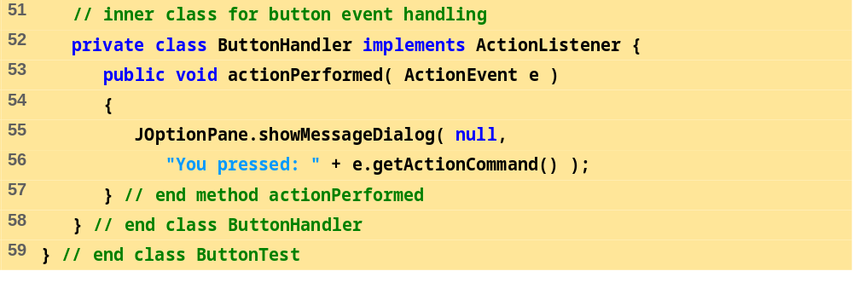
ButtonTest.java (Part 3 of 3)

Slide 38
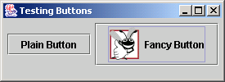
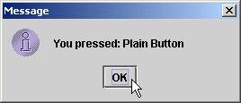
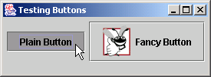
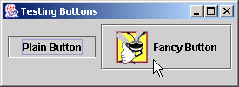
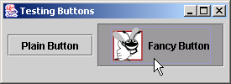
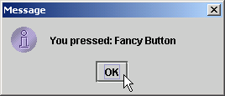
Program Output

Slide 39
29.8 JCheckBox
State buttons
  JToggleButton
    Subclasses JCheckBox, JRadioButton
  Have on/off (true/false) values
  We discuss JCheckBox in this section
Initialization
  JCheckBox myBox = new JCheckBox( "Title" );
When JCheckBox changes
  ItemEvent generated
    Handled by an ItemListener, which must define itemStateChanged
  Register with addItemListener

Slide 40
29.8 JCheckBox
ItemEvent methods
  getStateChange
    Returns ItemEvent.SELECTED or ItemEvent.DESELECTED

Slide 41
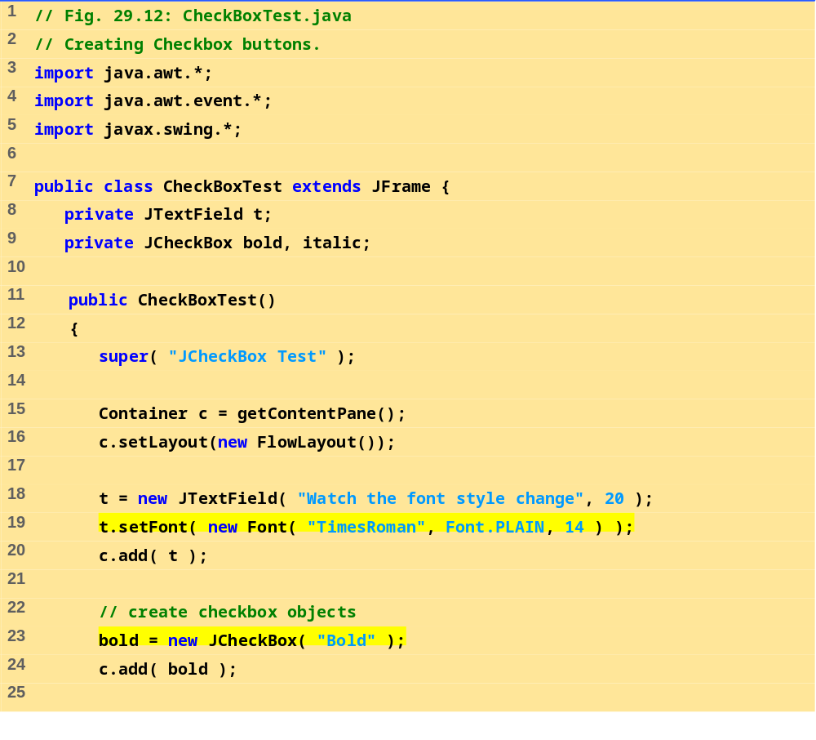
CheckBoxTest.java (Part 1 of 3)

Slide 42
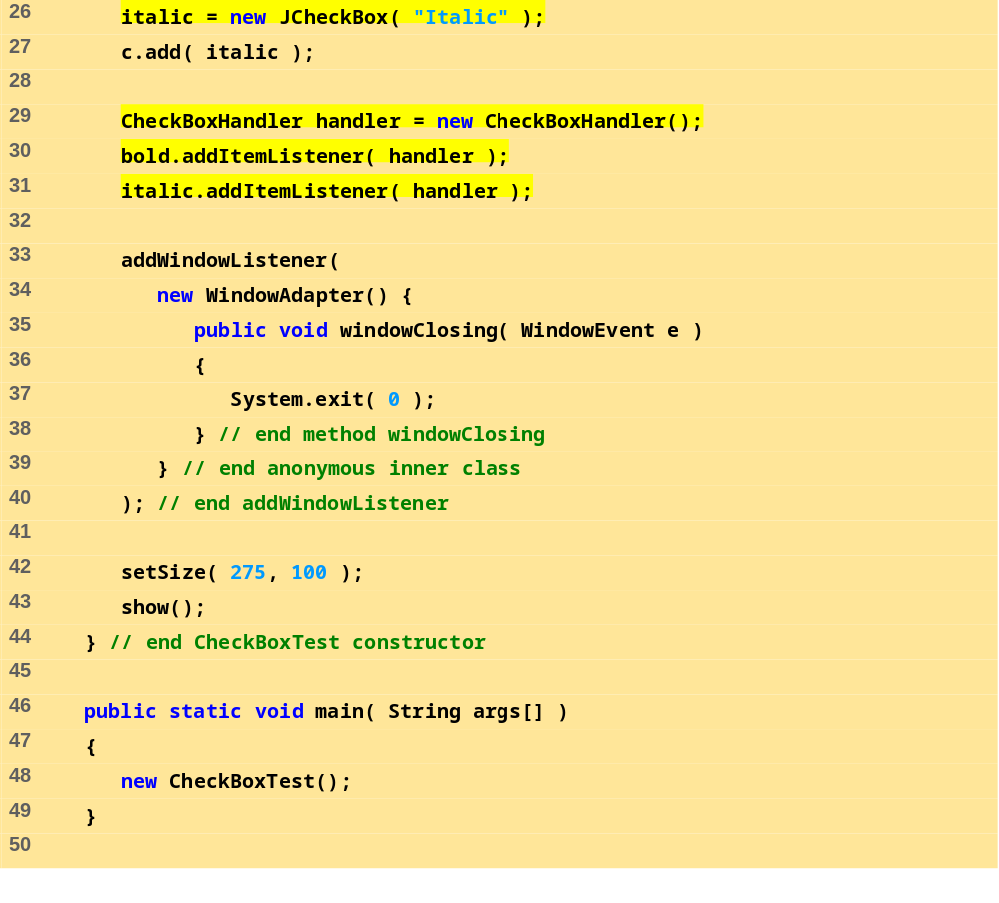
CheckBoxTest.java (Part 2 of 3)

Slide 43
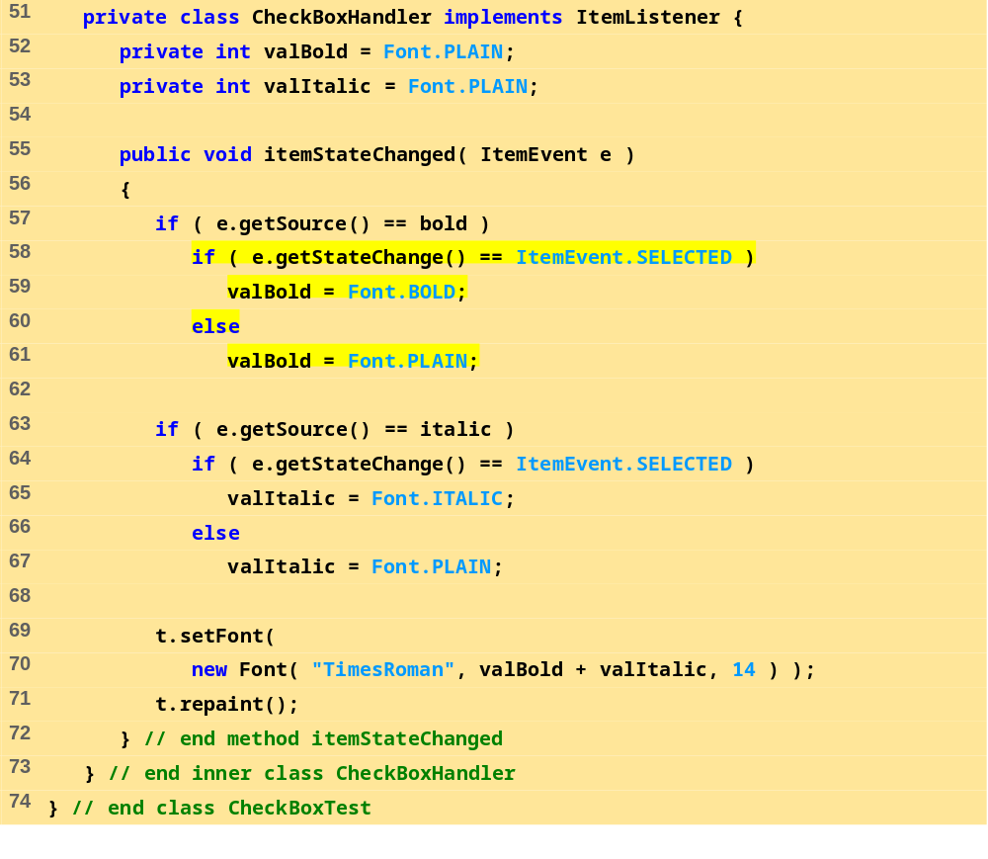
CheckBoxTest.java (Part 3 of 3)
Because CheckBoxHandler implements ItemListener, it must define method itemStateChanged

Slide 44
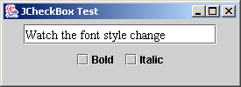
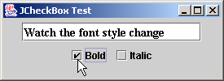
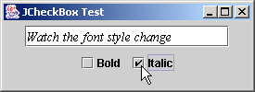
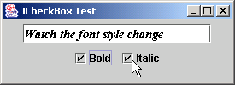
Program Output

Slide 45
29.9 JComboBox
Combo box (drop down list)
  List of items, user makes a selection
  Class JComboBox
    Generate ItemEvents
JComboBox
  Numeric index keeps track of elements
    First element added at index 0
    First item added is appears as currently selected item when combo box appears

Slide 46
29.9 JComboBox
Methods
  getSelectedIndex
    Returns the index of the currently selected item
  setMaximumRowCount( n )
    Set the maximum number of elements to display when user clicks combo box
    Scrollbar automatically provided

Slide 47
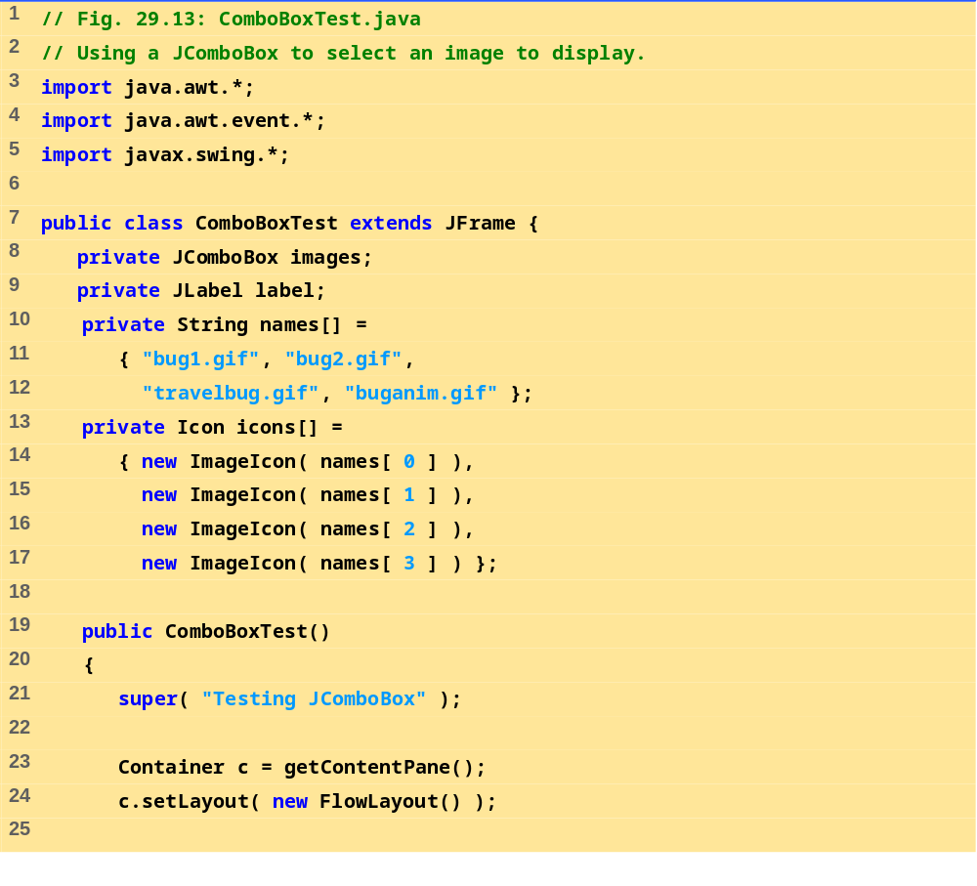
ComboBoxTest.java (Part 1 of 3)

Slide 48
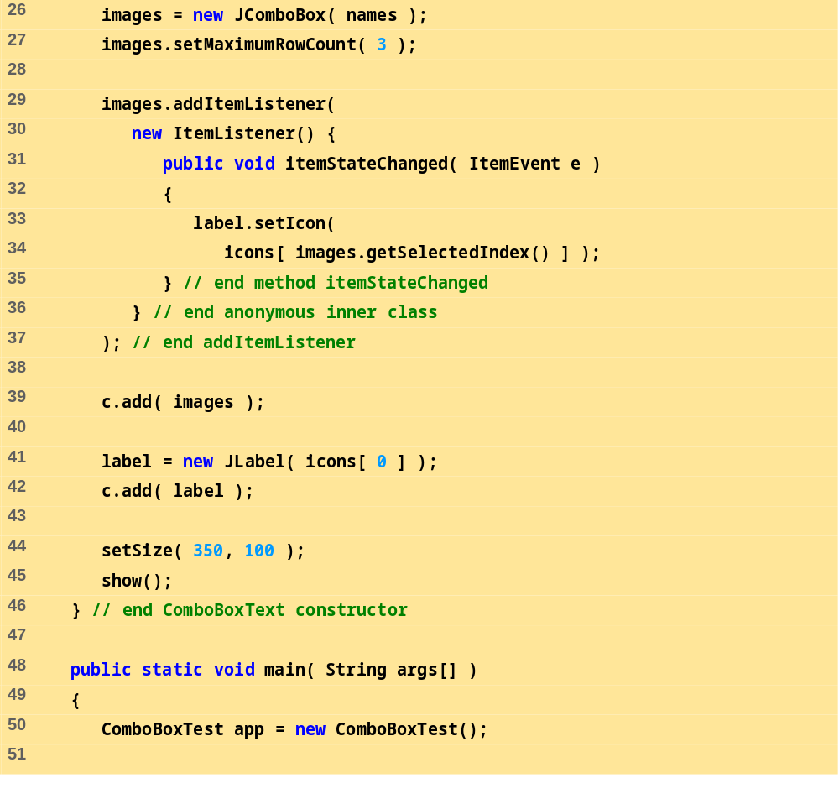
ComboBoxTest.java (Part 2 of 3)

Slide 49
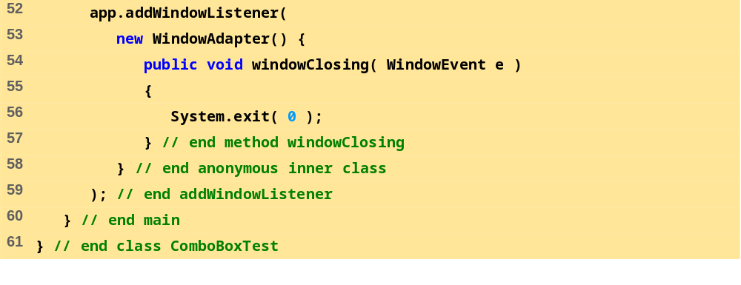
ComboBoxTest.java (Part 3 of 3)

Slide 50
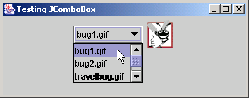
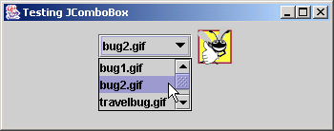
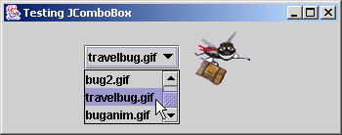
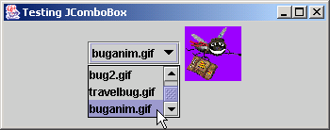
Program Output
Scroll box
Scroll arrows
A scrollbar to scroll through the items in the list.

Slide 51
29.10 Mouse Event Handling
Mouse events
  Can be trapped for any GUI component derived from java.awt.Component
  Mouse event handling methods
    Take a MouseEvent object
      Contains info about event, including x and y coordinates
      Methods getX and getY
  MouseListener and MouseMotionListener methods called automatically (if component is registered)
    addMouseListener
    addMouseMotionListener

Slide 52
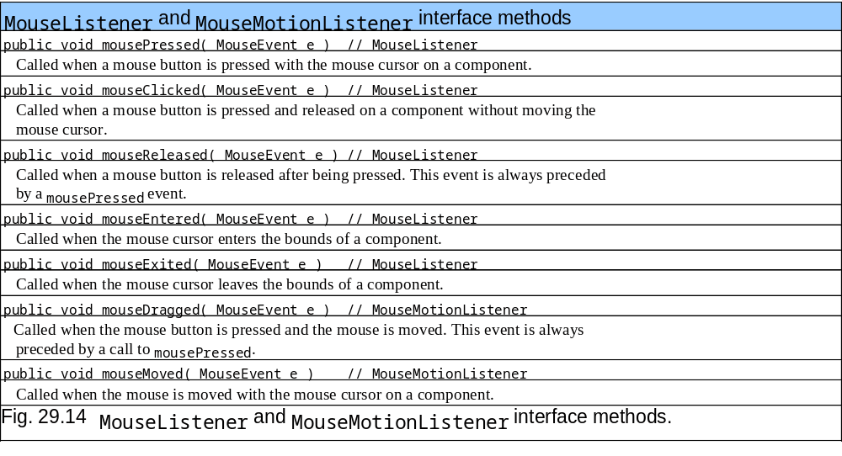
29.10 Mouse Event Handling
Interface methods for MouseListener and MouseMotionListener

Slide 53
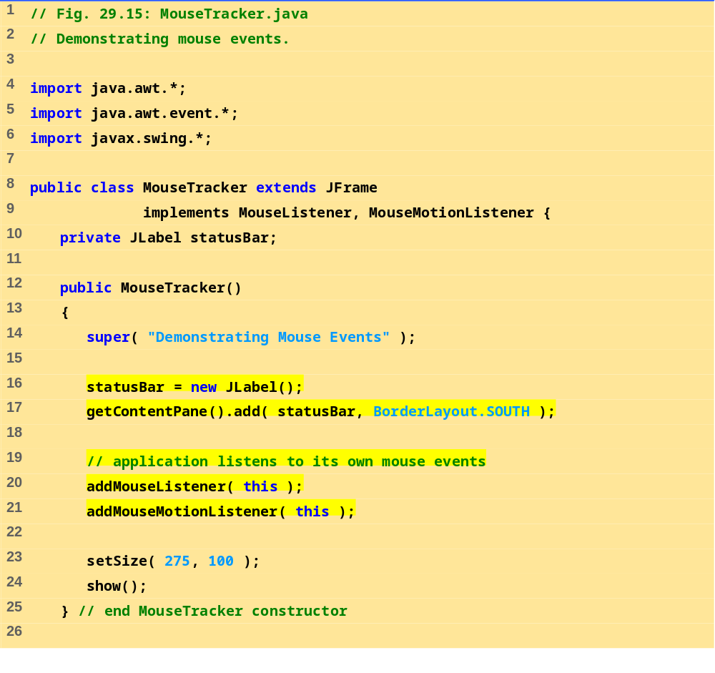
MouseTracker.java (Part 1 of 4)

Slide 54

MouseTracker.java (Part 2 of 4)

Slide 55

MouseTracker.java (Part 3 of 4)

Slide 56

MouseTracker.java (Part 4 of 4)

Slide 57







Program Output

Slide 58
29.11 Layout Managers
Layout managers
  Arrange GUI components on a container
  Provide basic layout capabilities
    Easier to use than determining exact size and position of every component
    Programmer concentrates on "look and feel" rather than details

Slide 59

29.11 Layout Managers

Slide 60
29.11.1 FlowLayout
Most basic layout manager
  Components placed left to right in order added
  When edge of container reached, continues on next line
  Components can be left-aligned, centered (default), or right-aligned
Method
  setAlignment
    FlowLayout.LEFT, FlowLayout.CENTER, FlowLayout.RIGHT
  layoutContainer( Container )
    Update Container specified with layout

Slide 61

FlowLayout-Demo.java
(1 of 4)

Slide 62

FlowLayout-Demo.java
(2 of 4)

Slide 63

FlowLayout-Demo.java
(3 of 4)

Slide 64

FlowLayout-Demo.java
(4 of 4)

Slide 65




29.11.1 FlowLayout
Fig. 29.17 Program that demonstrates components in FlowLayout.

Slide 66
29.11.2 BorderLayout
BorderLayout
  Default manager for content pane
  Arrange components into 5 regions
    North, south, east, west, center
  Up to 5 components can be added directly
    One for each region
  Components placed in
    North/South - Region is as tall as component
    East/West - Region is as wide as component
    Center - Region expands to take all remaining space

Slide 67

BorderLayout-Demo.java
(1 of 3)

Slide 68

BorderLayout-Demo.java
(2 of 3)

Slide 69

BorderLayoutDemo.java
(3 of 3)

Slide 70




29.11.2 BorderLayout
Fig. 29.18 Demonstrating components in BorderLayout.

Slide 71


29.11.2 BorderLayout
Fig. 29.18 Demonstrating components in BorderLayout.

Slide 72
29.11.2 BorderLayout
Methods
  Constructor: BorderLayout( hGap, vGap );
    hGap - horizontal gap space between regions
    vGap - vertical gap space between regions
    Default is 0 for both
  Adding components
    myLayout.add( component, position )
    component - component to add
    position - BorderLayout.NORTH
      SOUTH, EAST, WEST, CENTER similar
  setVisible( boolean ) ( in class JButton)
    If false, hides component
  layoutContainer( container ) - updates container, as before

Slide 73
29.11.3 GridLayout
GridLayout
  Divides container into a grid
  Components placed in rows and columns
  All components have same width and height
    Added starting from top left, then from left to right
    When row full, continues on next row, left to right
Constructors
  GridLayout( rows, columns, hGap, vGap );
    Specify number of rows and columns, and horizontal and vertical gaps between elements (in pixels)
  GridLayout( rows, columns );
    Default 0 for hGap and vGap

Slide 74
29.11.3 GridLayout
Updating containers
  Container method validate
    Re-computes the layout for a Container
  Example:
    c.validate();
    Changes layout and updates c if condition met

Slide 75

GridLayoutDemo.java
(1 of 3)

Slide 76

GridLayout-Demo.java
(2 of 3)

Slide 77

GridLayout-Demo.java
(3 of 3)

Slide 78


29.11.3 GridLayout
Fig. 29.19 Program that demonstrates components in GridLayout.

Slide 79
29.12 Panels
Complex GUIs
  Each component needs to be placed in an exact location
  Can use multiple panels
    Each panel's components arranged in a specific layout
Panels
  Class JPanel inherits from JComponent, which inherits from java.awt.Container
    Every JPanel is a Container
  JPanels can have components (and other JPanels) added to them
    JPanel sized to components it contains
    Grows to accommodate components as they are added

Slide 80
29.12 Panels
Usage
  Create panels, and set the layout for each
  Add components to the panels as needed
  Add the panels to the content pane (default BorderLayout)

Slide 81

PanelDemo.java
(1 of 2)

Slide 82

PanelDemo.java
(2 of 2)

Slide 83

29.12 Panels
Fig. 29.20 A JPanel with five JButtons in a GridLayout attached to the SOUTH region of a BorderLayout.

Slide 84
29.13 Creating a Self-Contained Subclass of JPanel
JPanel
  Can be used as a dedicated drawing area
    Receive mouse events
    Can extend to create new components
  Combining Swing GUI components and drawing can lead to improper display
    GUI may cover drawing, or may be able to draw over GUI components
  Solution: separate the GUI and graphics
    Create dedicated drawing areas as subclasses of JPanel

Slide 85
29.13 Creating a Self-Contained Subclass of JPanel
Swing components inheriting from JComponent
  Contain method paintComponent
    Helps to draw properly in a Swing GUI
  When customizing a JPanel, override paintComponent public void paintComponent( Graphics g )
  {
  super.paintComponent( g );
  //additional drawing code
  }
  Call to superclass paintComponent ensures painting occurs in proper order
    The call should be the first statement - otherwise, it will erase any drawings before it

Slide 86
29.13 Creating a Self-Contained Subclass of JPanel
JFrame and JApplet
  Not subclasses of JComponent
    Do not contain paintComponent
  Override paint to draw directly on subclasses
Events
  JPanels do not create events like buttons
  Can recognize lower-level events
    Mouse and key events

Slide 87
29.13 Creating a Self-Contained Subclass of JPanel
Example
  Create a subclass of JPanel named SelfContainedPanel that listens for its own mouse events
    Draws an oval on itself (overrides paintComponent)
  Import SelfContainedPanel into another class
    The other class contains its own mouse handlers
  Add an instance of SelfContainedPanel to the content pane

Slide 88

SelfContained-PanelTest
.java (1 of 3)

Slide 89

SelfContained-PanelTest
.java (2 of 3)

Slide 90

SelfContained-PanelTest
.java (3 of 3)

Slide 91

SelfContained-Panel.java (1 of 3)

Slide 92

SelfContained-Panel.java (2 of 3)

Slide 93

SelfContained-Panel.java (3 of 3)

Slide 94



29.13 Creating a Self-Contained Subclass of JPanel
Fig. 29.21 Capturing mouse events with a JPanel—SelfContainedPanel.java.

Slide 95
29.14 Windows
JFrame
  Inherits from java.awt.Frame, which inherits from java.awt.Window
  JFrame is a window with a title bar and a border
    Not a lightweight component - not written completely in Java
    Window part of local platform's GUI components
      Different for Windows, Macintosh, and UNIX
JFrame operations when user closes window
  Controlled with method setDefaultCloseOperation
    Interface WindowConstants (javax.swing) has three constants to use
    DISPOSE_ON_CLOSE, DO_NOTHING_ON_CLOSE, HIDE_ON_CLOSE (default)

Slide 96
29.14 Windows
Windows take up valuable resources
  Explicitly remove windows when not needed with method dispose (of class Window, indirect superclass of JFrame)
    Or, use setDefaultCloseOperation
  DO_NOTHING_ON_CLOSE - you determine what happens when user wants to close window
Display
  By default, window not displayed until method show called
  Can display by calling method setVisible( true )
  Method setSize - make sure to set a window's size, otherwise only the title bar will appear

Slide 97
29.14 Windows
All windows generate window events
  addWindowListener
  WindowListener interface has 7 methods
    windowActivated
    windowClosed (called after window closed)
    windowClosing (called when user initiates closing)
    windowDeactivated
    windowIconified (minimized)
    windowDeiconified
    windowOpened

Slide 98
29.15 Using Menus with Frames
Menus
  Important part of GUIs
  Perform actions without cluttering GUI
  Attached to objects of classes that have method setJMenuBar
    JFrame and JApplet
Classes used to define menus
  JMenuBar - container for menus, manages menu bar
  JMenuItem - manages menu items
    Menu items - GUI components inside a menu
    Can initiate an action or be a submenu

Slide 99
29.15 Using Menus with Frames
Classes used to define menus (continued)
  JMenu - manages menus
    Menus contain menu items, and are added to menu bars
    Can be added to other menus as submenus
    When clicked, expands to show list of menu items
  JCheckBoxMenuItem
    Manages menu items that can be toggled
    When selected, check appears to left of item
  JRadioButtonMenuItem
    Manages menu items that can be toggled
    When multiple JRadioButtonMenuItems are part of a group, only one can be selected at a time
    When selected, filled circle appears to left of item

Slide 100
29.15 Using Menus with Frames
Mnemonics
  Provide quick access to menu items (File)
    Can be used with classes that have subclass javax.swing.AbstractButton
  Use method setMnemonic
  JMenu fileMenu = new JMenu( "File" )
  fileMenu.setMnemonic( 'F' );
    Press Alt + F to access menu
Methods
  setSelected( true )
    Of class AbstractButton
    Sets button/item to selected state

Slide 101
29.15 Using Menus with Frames
Methods (continued)
  addSeparator()
    Class JMenu
    Inserts separator line into menu
Dialog boxes
  Modal - No other window can be accessed while it is open (default)
    Modeless - other windows can be accessed
  JOptionPane.showMessageDialog( parentWindow, String, title, messageType )
  parentWindow - determines where dialog box appears
    null - displayed at center of screen
    window specified - dialog box centered horizontally over parent

Slide 102
29.15 Using Menus with Frames
Using menus
  Create menu bar
    Set menu bar for JFrame ( setJMenuBar( myBar );
  Create menus
    Set Mnemonics
  Create menu items
    Set Mnemonics
    Set event handlers
  If using JRadioButtonMenuItems
    Create a group: myGroup = new ButtonGroup();
    Add JRadioButtonMenuItems to the group

Slide 103
29.15 Using Menus with Frames
Using menus (continued)
  Add menu items to appropriate menus
    myMenu.add( myItem );
    Insert separators if necessary: myMenu.addSeparator();
  If creating submenus, add submenu to menu
    myMenu.add( mySubMenu );
  Add menus to menu bar
    myMenuBar.add( myMenu );
Example
  Use menus to alter text in a JLabel
  Change color, font, style
  Have a "File" menu with a "About" and "Exit" items

Slide 104

MenuTest.java (1 of 7)

Slide 105

MenuTest.java (2 of 7)

Slide 106

MenuTest.java (3 of 7)

Slide 107

MenuTest.java (4 of 7)

Slide 108

MenuTest.java (5 of 7)

Slide 109

MenuTest.java (6 of 7)

Slide 110

MenuTest.java (7 of 7)

Slide 111

29.15 Using Menus with Frames
Fig. 29.22 Using JMenus and mnemonics.
Menu
Menu bar
Mnemonics

Slide 112

29.15 Using Menus with Frames
Fig. 29.22 Using JMenus and mnemonics.
Expanded submenu
Menu items
Separator

